Slide 1
Introduction

Slide 2
Description of project

Slide 3
Why we chose this project?

Slide 4
What roles team members played?

Slide 5
About our data

Slide 6
Core Goals & Stretch Goals

Slide 7
SafE Agile – Sprint breakdown

Slide 8
Core Goal 1 - CNN

Slide 9
Core Goal 2 - FasterRCNN

Slide 10
Core Goal 3 - YOLO
History and architecture
Darknet

Slide 11
Core Goal 3 - YOLO
Approach taken
Pre-trained model
Training with frozen layer
TensorBoard output

Slide 12
Core Goal 3 - YOLO
Results:
Comparison between models created
Sample images
Sample videos

Slide 13
Core Goal 3 - YOLO
Results:
Why the difference?
Challenges faced?
ARGO experience

Slide 14
Core Goal 4 - SSD

Slide 15
Stretch Goals #1

Slide 16
Stretch Goals #2

Slide 17
Stretch Goals #3

Slide 18
Stretch Goals #4

Slide 19
With more time…

Slide 20
Challenges / Learnings

Slide 21
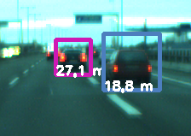
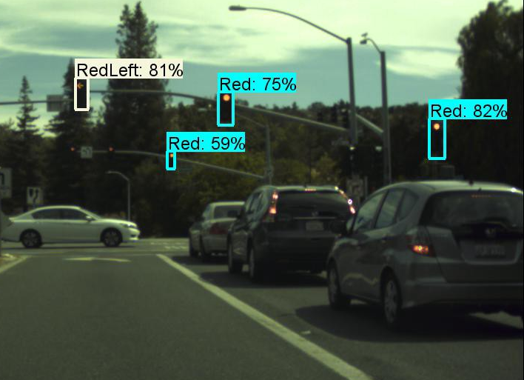
Concept Applications
Cars
Self-driving
Pedestrian detection
Digital Mapping
Google Maps/Waze recognizing street signs, speed limits…
Extension of Google Earth & Google Street View
Security
Facial Recognition Systems

Slide 22
References
alexattia. (2018). The Simpsons Character Dataset. Retrieved from Kaggle:
https://www.kaggle.com/alexattia/the-simpsons-characters-dataset
Brownlee, J. (2017, August 21). CNN Long Short-Term Memory Networks. Retrieved
from Machine Learning Mastery: https://machinelearningmastery.com/cnn-
long-short-term-memory-networks/
Chollet, F. (2016, June 5). Building powerful image classification models using very little data.
Retrieved from The Keras Blog: https://blog.keras.io/building-powerful-image-
classification-models-using-very-little-data.html
Crawford, C. (2016, November 4). An Introduction to Deep Learning. Retrieved from Algorithmia:
https://blog.algorithmia.com/introduction-to-deep-learning/

Slide 23
References
Duc, N. V. (2011, May 20). Object detection and distance calculation
based on stereo vision technique. Retrieved from YouTube:
https://www.youtube.com/watch?v=PR9tlFay0U8
Gandhi, R. (2018, May 18). Build Your Own Convolutional Neural Network in
5 mins. Retrieved from Towards Data Science:
https://towardsdatascience.com/build-your-own-convolution-neural-
network-in-5-mins-4217c2cf964f
Girshick, R. (2014, September 27). Fast R-CNN. (Cornell University) Retrieved from
arXiv.org: https://arxiv.org/abs/1504.08083
Kaiming He, G. G. (2018, January 24). Mask R-CNN. (Cornell University) Retrieved from arXiv.org:
https://arxiv.org/abs/1703.06870

Slide 24
References
Duc, N. V. (2011, May 20). Object detection and distance calculation
based on stereo vision technique. Retrieved from YouTube:
https://www.youtube.com/watch?v=PR9tlFay0U8
Gandhi, R. (2018, May 18). Build Your Own Convolutional Neural Network in
5 mins. Retrieved from Towards Data Science:
https://towardsdatascience.com/build-your-own-convolution-neural-
network-in-5-mins-4217c2cf964f
Girshick, R. (2014, September 27). Fast R-CNN. (Cornell University) Retrieved from
arXiv.org: https://arxiv.org/abs/1504.08083
Kaiming He, G. G. (2018, January 24). Mask R-CNN. (Cornell University) Retrieved from arXiv.org:
https://arxiv.org/abs/1703.06870

Slide 25
References
Kaiming He, X. Z. (2015, December 10). Deep Residual Learning for
Image Recognition. Retrieved from arXiv.org:
https://arxiv.org/abs/1512.03385
Madrigal, A. C. (2012, September 6). How Google Builds Its Maps—and
What It Means for the Future of Everything. Retrieved from The
Atlantic: https://www.theatlantic.com/technology/archive/2012
/09/how-google-builds-its-maps-and-what-it-means-for-the-
future-of-everything/261913/
qqwweee. (2018, April 2). keras-yolo3. Retrieved from GitHub:
https://github.com/qqwweee/keras-yolo3

Slide 26
References
Ross Girshick, J. D. (2014, October 22). Rich feature hierarchies for accurate
object detection and semantic segmentation. (Cornell University)
Retrieved from arXiv.org: https://arxiv.org/abs/1311.2524
Sarkis, A. (2017, September 19). Self-Driving Cars: Implementing Real-Time Traffic
Light Detection and Classification in 2017. Retrieved July 27, 2019, from
Medium: https://medium.com/@anthony_sarkis/self-driving-cars-implementing-
real-time-traffic-light-detection-and-classification-in-2017-7d9ae8df1c58
Shaoqing Ren, K. H. (2016, January 6). Faster R-CNN: Towards Real-Time Object Detection with
Region Proposal Networks. (Cornell University) Retrieved from arXiv.org:
https://arxiv.org/abs/1506.01497

Slide 27
References
Sharma, J. G. (27, September 2018). Deep CNN-ELM Hybrid Models for
Fire Detection in Images. doi:https://doi.org/10.1007/978-3-030-
01424-7_25
Shoji Kido, Y. H. (2019, May 31). Detection and classification of lung
abnormalities by use of convolutional neural network (CNN) and
regions with CNN features (R-CNN). (IEEE) Retrieved from IEEE Xplore
Digital Library: https://ieeexplore.ieee.org/document/8369798
Simplilearn. (2018, June 19). Convolutional Neural Network Tutorial (CNN) |
How CNN Works | Deep Learning Tutorial | Simplilearn. Retrieved
from YouTube: https://www.youtube.com/watch?v=Jy9-aGMB_TE

Slide 28
References
Skymind. (n.d.). A Beginner's Guide to Neural Networks and Deep
Learning. Retrieved from Skymind AI:
https://skymind.ai/wiki/neural-network#define
Stark, H. (2017, April 26). Since You Asked, Here's How Google Maps Really
Works. Retrieved from Forbes:
https://www.forbes.com/sites/haroldstark/2017/04/26/since-you-
asked-heres-how-google-maps-really-works/#56822cb34dbe
Suresh Prasad Kannojia, G. J. (2018, September 27). Ensemble of Hybrid CNN-
ELM Model for Image Classification. Retrieved from IEEE Xplore Digital
Library: https://ieeexplore.ieee.org/document/8474196/authors#authors

